Slide 1
Welcome to The New BNI Online PowerPoint doc
The new BNI Online PowerPoint document, updated April 2021, includes visually appealing transitions and new and improved images, gifs, and videos to enhance the BNI Online meeting experience.
This file can be accessed on both BNI Business Builder and BrandShare and can be downloaded to the chapter president’s local computer.
Due to its components, the file may be too big to send as an email attachment. If that is the case, please direct the recipient to BNI Business Builder, BrandShare, or other file transfer platforms designed to share large files.

Slide 2
WELCOME TO
<<Chapter Name>>
Monday, 26 September 2022

Slide 3
Please Check Your Connections
Check your connections – Wi-Fi, audio and video.
Please prepare yourself for our bni online meeting.

Slide 4
We Will Not Be Recording
Disclaimer
We (BNI Global, LLC and its Franchisees) will not be taking any audio and/or video recordings and/or screenshots of this Chapter. If you, as a participant of this Chapter Meeting, wish to take screenshots of any Chapter Meeting, it is your responsibility to let your fellow Members know that you may be doing so and/or gain their permission if required by law. Aside from screenshots, we discourage participants from creating audio or video recordings of this chapter meeting. https://www.bni.com/privacy-policy

Slide 5
Special Announcements
President – Welcome Visitors -
“Welcome to the BNI® (CHAPTER NAME). Thank you for participating in today’s unique BNI Online Virtual Meeting! Remember, just a few special announcements today:
Please mute your line, but keep your video on.
Please be sure you’re using a high-quality headset and webcam.
We recommend a high-speed internet connection.
Be sure you’re in front of a professional background, and
wearing attire appropriate for a Chapter Meeting, with your badge and pin
Ensure that your camera is zoomed appropriately
Avoid asking us if we can hear you when it’s your turn, and
Project your video and unmute yourself only when it’s your turn for the Member presentation.
Members and visitors Please turn off or silence your electronic devices.

Slide 6
Our Core Values
Givers Gain®
Traditions + Innovation
Building Relationships
Positive Attitude
Lifelong Learning
Accountability
Recognition

Slide 7
Our Core Values
1. Givers Gain®
4. Traditions + Innovation
Givers Gain is the underlying philosophy of BNI. We exemplify that by giving business to others; you will get business in return
Tradition in an organization tells us where we come from and lays the foundation of who we are, but we must always be looking for ways to innovate.
2. Building Relationships
5. Positive Attitude
Networking is more about farming connections with new contacts than hunting for them. People want to do business with people they know and trust. It’s about cultivating those relationships.
BNI provides an environment that enables you to surround yourself with people who want to help you succeed.
6. Accountability
3. Lifelong Learning
If you want to have a powerful personal network, you must have accountability. Otherwise, it becomes a social group.
We believe in the continuous improvement of personal and professional skills. BNI provides a variety of opportunities to support lifelong learning.
7. Recognition
It’s important to recognize those who are contributing.

Slide 8
Welcome to Our Guests
First & last names
Professional category
Invited by: First & last names (Member)
First & last names
Professional category
Invited by: First & last names (Member)
First & last names
Professional category
Invited by: First & last names (Member)

Slide 9
Your Leadership Team
Vice President
First & last name
President
First & last name
Secretary Treasurer
First & last name

Slide 10
Team Roles
Membership Committee
First & last name
First & last name
First & last name
First & last name
Coordinator Roles
Education | First & last name
Power Teams | First & last name
Mentoring | First & last name
Events & Training | First & last name
Visitor Hosts
First & last name, First & last name, First & last name, First & last name,

Slide 11
BNI Regional District Consultant/Ambassador
Name
Business Name
Phone Number
Email Address
Website

Slide 12
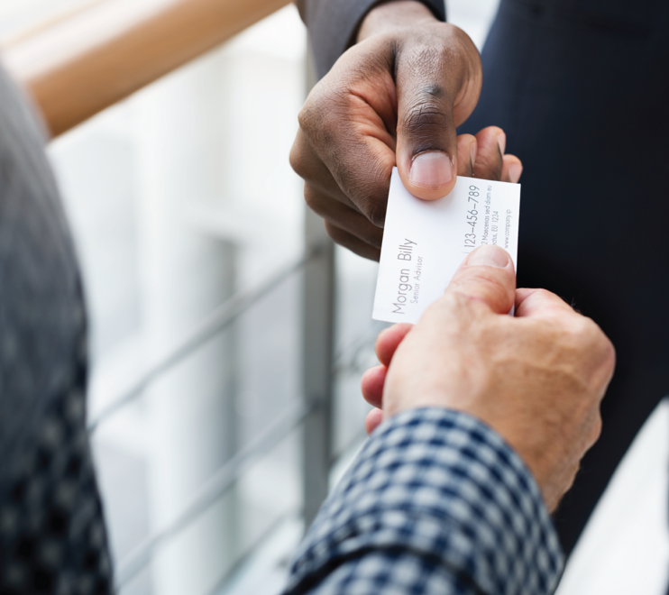
Purpose & Overview
Notes:
BNI® is the most successful organization of its type in the world. There are currently almost 10,000 Chapters and more than 270,000 Members in 72 countries globally. Members of BNI® have passed millions of referrals and this translates into billions of dollars in business being passed between our Members. The philosophy of BNI® is Givers Gain®: If I give business to the Members of my Chapter, in return they will want to give business to me

Slide 13
Networking Education

Slide 14
Vice President’s First Report
Introducing Your Chapter’s Networking Leaders
BNI® Network Leaders
(Month/Year)
#1 in Attendance:
#1 in One-to-Ones:
#1 in Chapter Education Units:
#1 in Visitors:
#1 in Referrals:
#1 in Thank You for Closed Business:

Slide 16
Weekly Presentations
Members, please give a brief overview of your business
staying within the chapter time limit of 60 seconds.
We will go alphabetically by first name.
Visitors, you will be introduced after all the Members
have presented.

Slide 17
Specialty | Member
Sign Company | First & last name
Printer | First & last name
Mailing Service | First & last name
Digital Marketing | First & last name
Web Design | First & last name
Photographer | First & last name
Promotional Products | First & last name
POWER TEAM
Marketing & Events

Slide 18
Weekly Presentation
Name
Business Name
Phone Number
Email Address
Website
Next Presenter:
Next Slide’s Member Name
0
1
2
3
4
5
6
7
8
9
10
11
12
13
14
15
16
17
18
19
20
21
22
23
24
25
26
27
28
29
30
31
32
33
34
35
36
37
38
39
40
41
42
43
44
45

Slide 19
Specialty | Member
Property & Casualty Insurance | First & last name
Pest Control | First & last name
Auto/Car Repair | First & last name
Carpet, Upholstery Cleaning | First & last name
HVAC | First & last name
Restoration | First & last name
Cleaning Service | First & last name
POWER TEAM
Home & Auto

Slide 20
Weekly Presentation
Name
Business Name
Phone Number
Email Address
Website
Next Presenter:
Next Slide’s Member Name
0
1
2
3
4
5
6
7
8
9
10
11
12
13
14
15
16
17
18
19
20
21
22
23
24
25
26
27
28
29
30
31
32
33
34
35
36
37
38
39
40
41
42
43
44
45

Slide 21
Specialty | Member
Financial Advisor | First & last name
Tax Advisor | First & last name
Life & Disability Insurance | First & last name
Estate Planning Law | First & last name
Commercial Insurance | First & last name
IT & Networks | First & last name
Bookkeeping | First & last name
POWER TEAM
Business & Financial

Slide 22
Weekly Presentation
Name
Business Name
Phone Number
Email Address
Website
Next Presenter:
Next Slide’s Member Name
0
1
2
3
4
5
6
7
8
9
10
11
12
13
14
15
16
17
18
19
20
21
22
23
24
25
26
27
28
29
30
31
32
33
34
35
36
37
38
39
40
41
42
43
44
45

Slide 23
Specialty | Member
Chiropractor | First & last name
Health Insurance | First & last name
Personal Injury Law | First & last name
Message Therapist | First & last name
General Dentist | First & last name
Nutritional Supplements | First & last name
Eye Care | First & last name
POWER TEAM
Health & Beauty

Slide 24
Weekly Presentation
Name
Business Name
Phone Number
Email Address
Website
Next Presenter:
Next Slide’s Member Name
0
1
2
3
4
5
6
7
8
9
10
11
12
13
14
15
16
17
18
19
20
21
22
23
24
25
26
27
28
29
30
31
32
33
34
35
36
37
38
39
40
41
42
43
44
45

Slide 25
Specialty | Member
Residential Agent | First & last name
Residential Mortgages | First & last name
Title Services | First & last name
Property Management | First & last name
Builder/General Contractor | First & last name
Real Estate Inspector | First & last name
Roofing and Gutters | First & last name
POWER TEAM
Real Estate Services

Slide 26
Weekly Presentation
Name
Business Name
Phone Number
Email Address
Website
Next Presenter:
Next Slide’s Member Name
0
1
2
3
4
5
6
7
8
9
10
11
12
13
14
15
16
17
18
19
20
21
22
23
24
25
26
27
28
29
30
31
32
33
34
35
36
37
38
39
40
41
42
43
44
45

Slide 27
?
Members Weekly Presentation
Did We Miss Anyone

Slide 28
Guest Introductions
Your Name & Company
Describe What You Do
How Can We Help You?

Slide 29
Speaker Rotation
Speakers
Today | First & last name
[Insert next week’s date] | First & last name
[Insert date] | First & last name
[Insert date] | First & last name
[Insert date] | First & last name
[Insert date] | First & last name
[Insert date] | First & last name

Slide 30
First Feature Presentation
Name
Business Name
Website
2
3
4
5
60
0
1
2
3
4
5
6
7
8
9
10
11
12
13
14
15
16
17
18
19
20
21
22
23
24
25
26
27
28
29
30
31
32
33
34
35
36
37
38
39
40
41
42
43
44
45
46
47
48
49
50
51
52
53
54
55
56
57
58
59
min
sec

Slide 31
Second Feature Presentation
Name
Business Name
Website
2
3
4
5
60
0
1
2
3
4
5
6
7
8
9
10
11
12
13
14
15
16
17
18
19
20
21
22
23
24
25
26
27
28
29
30
31
32
33
34
35
36
37
38
39
40
41
42
43
44
45
46
47
48
49
50
51
52
53
54
55
56
57
58
59
min
sec

Slide 32
Referrals & Testimonials
To our Members: Please start your sentence with “I Have”
To our Visitors:
After the Members have finished, I will give you the opportunity to tell
us, in ONE WORD, what impressed you the most about the meeting.
This will also be your opportunity to give referrals.
I HAVE referrals for…..
I HAVE visitors today…..
I HAVE Thank you for closed business…
I HAVE a testimonial for … (one testimonial per meeting please)
I HAVE learned something new today…….

Slide 33
Referrals & Testimonials
Name
Business Name
What Are Your
Positive Contributions
This Week?
Next Presenter:
Next Slide’s Member Name

Slide 34
Referrals & Testimonials
Member 1
Member 2
Member 3
…
Notes:
Option 2: List out members names on 1 slide so the order is known and quickly go around the room without changing slides.

Slide 35
VP Recognition Report
Use the VP Report and Chapter statistics to highlight and recognize a number.
“Our chapter passed XX Referrals this past month and conducted XX 1-2-1s. Think about how that is impacting our local business community! I also want to thank John Doe for leading the way with XX!

Slide 36
Vice President’s Second Report
Attendance:
One-to-Ones for the Chapter:
Chapter Education Units for the Chapter:
Visitors (1st time only) for the Chapter:
Referrals for the Chapter:
Goal for # of Referrals this month =
Amount of GROSS REVENUE GENERATED for the Chapter in the last 12 months = $
“We like to share this information with you every week because BNI is a marketing organization and marketing is goal driven.”
Notes:
We like to share this information with you every week because BNI is a marketing organization and marketing is goal driven.

Slide 37
Notable Networkers
#1 Referrals Given:
#1 TYFCB Given:
#1 Visitors Brought:

Slide 38
Membership Committee Report
Chapter Education Units
Goal = 1 / week
#CEU / #weeks
1.0 + = 20 pts
0.75 – 0.99 = 15 pts
0.5 - .074 = 10 pts
0.25 – 0.49 = 5 pts
<0.25 = 0 pts

Slide 39
Membership Committee Report
Open Classifications
 | First & last name
 | First & last name
 | First & last name
 | First & last name
 | First & last name
 | First & last name
Pending Applications
 | First & last name
 | First & last name
 | First & last name
 | First & last name
 | First & last name
 | First & last name

Slide 40
Referral Reality Check

Slide 41
Secretary / Treasurer Report
Upcoming Renewals:
To our Visitors:
Thank you for visiting BNI All Stars!
If you would like to consider membership at BNI All Stars.
Visitor Orientation after the meeting
Complete Membership Application
Submit Membership Application & Fees

Slide 42
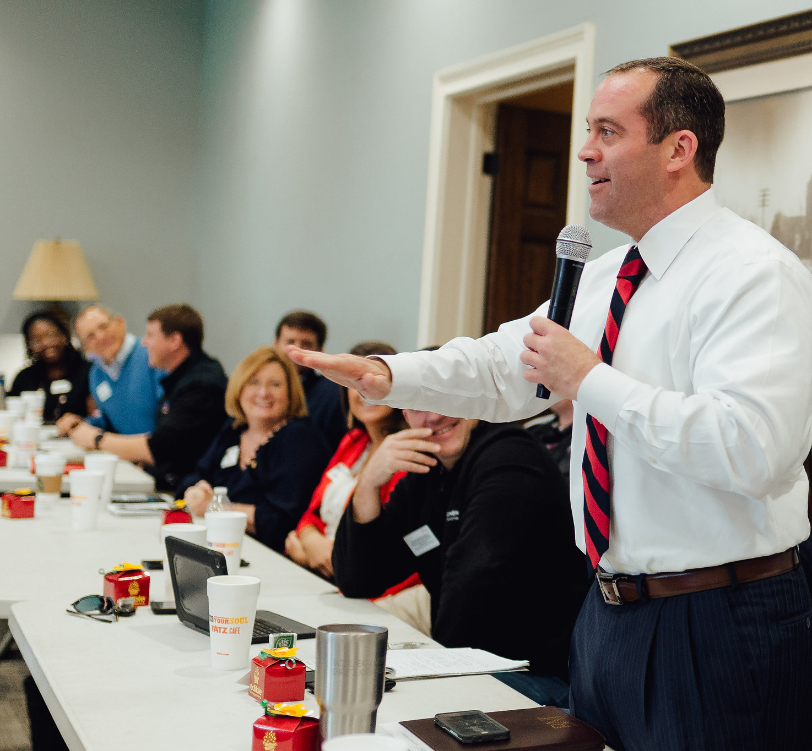
Thank You Visitors!
Please stay on the meeting afterwards for an orientation.

Slide 43
New & Renewing Members
New Members
Renewing Members
& Upcoming Anniversaries
First & last name
First & last name
First & last name
First & last name
First & last name
First & last name
First & last name
First & last name
First & last name
First & last name

Slide 44
Upcoming Training
Membership Success Program
pull dates from events page
Other Course Titles
pull dates from events page
Bnieast.ca/en-CA/events

Slide 45
Special Announcements

Slide 46
Closing Quote
“Insert Quote Of The Day”

Slide 47
Thank You!

Slide 48
Visitor Orientation

Slide 49
Additional Slides
See Following Slides That May Be Helpful For Your Meeting

Slide 50
We Will Be Recording
Disclaimer
We (BNI Global, LLC and its Franchisees) will be taking audio and/or video recordings and/or screenshots of this Chapter Meeting to post on our website [__________], social media platforms and/or to use in our worldwide trainings or marketing communications/materials, with some details about you and/or your business, in our legitimate interests and those of the Chapter Members, and/or to help promote the Chapter’s activities. If you would prefer that your details not be shared, please let the Chapter President know. If you, as a participant of this Chapter Meeting, wish to take screenshots of any Chapter Meeting, it is your responsibility to let your fellow Members know that you may be doing so and/or gain their permission if required by law. Aside from screenshots, we discourage participants from creating audio or video recordings of this chapter meeting. https://www.bni.com/privacy-policy

Slide 51
BNI Code Of Ethics
& Contract for Profitability
I will provide the quality of services at the prices that I have quoted.
I will be truthful with the members and their referrals.
I will build goodwill and trust among members and their referrals.
I will take responsibility for following up on the referrals I receive.
I will display a positive and supportive attitude with BNI members.
I will live up to the ethical standards of my profession.* *(Professional standards outlined in a formal code of ethics, supersede the above standards.)

Slide 52
BNI Code Of Ethics & Contract for Profitability (continued)
I will attend every meeting and when I am unable to attend, I will send a substitute to take my place and I understand that on the fourth absence within a six- month period, the Membership Committee may open my position to another qualified professional.
I will arrive on time each week and not leave early.
I will give good, qualified referrals.
Whenever possible and applicable, I will switch my personal
buying to appropriate members of my BNI chapter.

Slide 53
New Member Induction
Name
Business Name
Phone Number
Email Address
Website

Slide 54
Feature Presentations
See Following Slides For An Outline On Feature Presentations

Slide 55
First Feature Speaker
Name
Presentation Name
Business Name
Website
Notes:
Planning Link: https://scormengine.schoox.com/scormcontent/9f2be57b00a9263487287d93572fa4d3/story_content/external_files/Feature%20Presentation%20Planning%20Document%20(1).pdf
INTRO
Tell your story, including info about your company and how you got to where you are today
CHOOSE TWO:
Favorite story about how you solved a client problem
Doors your want to open or people/companies you’re looking to work with
Three types of referrals you are seeking and why
Things members can listen/look for
Share what members can say to bring you/your product into the conversation
CONCLUSION
Call to action – be specific with the types of referrals you are looking for
Invite members to schedule 1-2-1 with you as follow-up
TIPS
Write down what you want to say
Practice and rehearse your presentation (time yourself!)
Get feedback from someone else
Set up any materials in advance
Keep any handouts simple!

Slide 56
First Feature Speaker
Intro:
[Text]
[Text]
[Text]
Notes:
INTRO (2 mins)
Tell your story, including info about your company and how you got to where you are today

Slide 57
First Feature Speaker
Body:
[Text]
[Text]
[Text]
Notes:
BODY – Choose Two
Favorite story about how you solved a client problem
Doors your want to open or people/companies you’re looking to work with
Three types of referrals you are seeking and why
Things members can listen/look for
Share what members can say to bring you/your product into the conversation
Building another slide or two in this section is encouraged, as long as the section does not exceed the time!

Slide 58
First Feature Speaker
Call To Action:
[The best referral I am looking for is…]
Notes:
CONCLUSION (2 mins)
Call to action – be specific with the types of referrals you are looking for
Invite members to schedule 1-2-1 with you as follow-up

Slide 59
Weekly Presentation Timer Options
See Following 30- 90 Second Timer Option Slides

Slide 60
Weekly Presentation
Name
Business Name
Phone Number
Email Address
Website
Next Presenter:
Next Slide’s Member Name
0
1
2
3
4
5
6
7
8
9
10
11
12
13
14
15
16
17
18
19
20
21
22
23
24
25
26
27
28
29
30

Slide 61
Weekly Presentation
Name
Business Name
Phone Number
Email Address
Website
Next Presenter:
Next Slide’s Member Name
0
1
2
3
4
5
6
7
8
9
10
11
12
13
14
15
16
17
18
19
20
21
22
23
24
25
26
27
28
29
30
31
32
33
34
35

Slide 62
Weekly Presentation
Name
Business Name
Phone Number
Email Address
Website
Next Presenter:
Next Slide’s Member Name
0
1
2
3
4
5
6
7
8
9
10
11
12
13
14
15
16
17
18
19
20
21
22
23
24
25
26
27
28
29
30
31
32
33
34
35
36
37
38
39
40

Slide 63
Weekly Presentation
Name
Business Name
Phone Number
Email Address
Website
Next Presenter:
Next Slide’s Member Name
0
1
2
3
4
5
6
7
8
9
10
11
12
13
14
15
16
17
18
19
20
21
22
23
24
25
26
27
28
29
30
31
32
33
34
35
36
37
38
39
40
41
42
43
44
45

Slide 64
Weekly Presentation
Name
Business Name
Phone Number
Email Address
Website
Next Presenter:
Next Slide’s Member Name
0
1
2
3
4
5
6
7
8
9
10
11
12
13
14
15
16
17
18
19
20
21
22
23
24
25
26
27
28
29
30
31
32
33
34
35
36
37
38
39
40
41
42
43
44
45
46
47
48
49
50

Slide 65
Weekly Presentation
Name
Business Name
Phone Number
Email Address
Website
Next Presenter:
Next Slide’s Member Name
60
0
1
2
3
4
5
6
7
8
9
10
11
12
13
14
15
16
17
18
19
20
21
22
23
24
25
26
27
28
29
30
31
32
33
34
35
36
37
38
39
40
41
42
43
44
45
46
47
48
49
50
51
52
53
54
55
56
57
58
59

Slide 66
Weekly Presentation
Name
Business Name
Phone Number
Email Address
Website
Next Presenter:
Next Slide’s Member Name
0
1
2
3
4
5
6
7
8
9
10
11
12
13
14
15
16
17
18
19
20
21
22
23
24
25
26
27
28
29
30
31
32
33
34
35
36
37
38
39
40
41
42
43
44
45
46
47
48
49
50
51
52
53
54
55
56
57
58
59
60
61
62
63
64
65
66
67
68
69
70
71
72
73
74
75
76
77
78
79
80

Slide 67
Weekly Presentation
Name
Business Name
Phone Number
Email Address
Website
Next Presenter:
Next Slide’s Member Name
85
0
1
2
3
4
5
6
7
8
9
10
11
12
13
14
15
16
17
18
19
20
21
22
23
24
25
26
27
28
29
30
31
32
33
34
35
36
37
38
39
40
41
42
43
44
45
46
47
48
49
50
51
52
53
54
55
56
57
58
59
60
61
62
63
64
65
66
67
68
69
70
71
72
73
74
75
76
77
78
79
80
81
82
83
84
86
87
88
89
90

Slide 68
Feature Presentation Timer Options
See Following 6-12 Minute Timer Option Slides

Slide 69
Feature Presentation
Name
Business Name
Website
2
3
4
5
6
7
8
9
10
11
12
60
0
1
2
3
4
5
6
7
8
9
10
11
12
13
14
15
16
17
18
19
20
21
22
23
24
25
26
27
28
29
30
31
32
33
34
35
36
37
38
39
40
41
42
43
44
45
46
47
48
49
50
51
52
53
54
55
56
57
58
59
min
sec

Slide 70
Feature Presentation
Name
Business Name
Website
Next Presenter:
Next Slide’s Member Name
2
3
4
5
6
7
8
9
10
11
60
0
1
2
3
4
5
6
7
8
9
10
11
12
13
14
15
16
17
18
19
20
21
22
23
24
25
26
27
28
29
30
31
32
33
34
35
36
37
38
39
40
41
42
43
44
45
46
47
48
49
50
51
52
53
54
55
56
57
58
59
min
sec

Slide 71
Feature Presentation
Name
Business Name
Website
Next Presenter:
Next Slide’s Member Name
2
3
4
5
6
7
8
9
10
60
0
1
2
3
4
5
6
7
8
9
10
11
12
13
14
15
16
17
18
19
20
21
22
23
24
25
26
27
28
29
30
31
32
33
34
35
36
37
38
39
40
41
42
43
44
45
46
47
48
49
50
51
52
53
54
55
56
57
58
59
min
sec

Slide 72
Feature Presentation
Name
Business Name
Website
Next Presenter:
Next Slide’s Member Name
2
3
4
5
6
7
8
9
60
0
1
2
3
4
5
6
7
8
9
10
11
12
13
14
15
16
17
18
19
20
21
22
23
24
25
26
27
28
29
30
31
32
33
34
35
36
37
38
39
40
41
42
43
44
45
46
47
48
49
50
51
52
53
54
55
56
57
58
59
min
sec

Slide 73
Feature Presentation
Name
Business Name
Website
Next Presenter:
Next Slide’s Member Name
2
3
4
5
6
7
8
60
0
1
2
3
4
5
6
7
8
9
10
11
12
13
14
15
16
17
18
19
20
21
22
23
24
25
26
27
28
29
30
31
32
33
34
35
36
37
38
39
40
41
42
43
44
45
46
47
48
49
50
51
52
53
54
55
56
57
58
59
min
sec

Slide 74
Feature Presentation
Name
Business Name
Website
Next Presenter:
Next Slide’s Member Name
2
3
4
5
6
7
60
0
1
2
3
4
5
6
7
8
9
10
11
12
13
14
15
16
17
18
19
20
21
22
23
24
25
26
27
28
29
30
31
32
33
34
35
36
37
38
39
40
41
42
43
44
45
46
47
48
49
50
51
52
53
54
55
56
57
58
59
min
sec

Slide 75
Feature Presentation
Name
Business Name
Website
Next Presenter:
Next Slide’s Member Name
2
3
4
5
6
60
0
1
2
3
4
5
6
7
8
9
10
11
12
13
14
15
16
17
18
19
20
21
22
23
24
25
26
27
28
29
30
31
32
33
34
35
36
37
38
39
40
41
42
43
44
45
46
47
48
49
50
51
52
53
54
55
56
57
58
59
min
sec

Slide 76
Feature Presentation
Name
Business Name
Website
Next Presenter:
Next Slide’s Member Name
2
3
4
5
60
0
1
2
3
4
5
6
7
8
9
10
11
12
13
14
15
16
17
18
19
20
21
22
23
24
25
26
27
28
29
30
31
32
33
34
35
36
37
38
39
40
41
42
43
44
45
46
47
48
49
50
51
52
53
54
55
56
57
58
59
min
sec

Slide 77
Recipient’s Name
Chapter’s Name
Date
President’s Name

Slide 78
FOR THE MOST_______
Recipient’s Name
Chapter’s Name
Date
President’s Name

