Slide 1


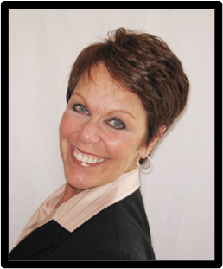
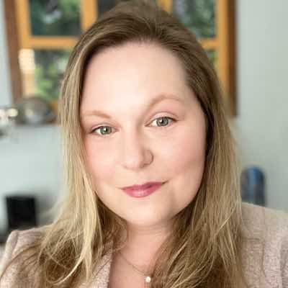
Welcome to the
2021/2022 Leadership Team Orientation
VISITOR HOSTS & COORDINATORS
Sherry Treesh
Area
Chapter Consultant
Indiana
Nicole Burke
Area
Chapter Consultant
British Columbia

Slide 2


YOU are a Visitor Host!
Congratulations!
It’s the best & most profitable role.
2021/2022 Leadership
Team Orientation

Slide 3



$1000 Visitor Experience!
vs
$200 Experience
2021/2022 Leadership
Team Orientation

Slide 4







5 STEPS TO HELP VISITORS ENJOY THE MEETING
Informative initial email series.
Warm welcome to the meeting. Setting expectations.
Introduce to potential referral partners & coach.
Smooth & informative orientation – asking for the app.
2021/2022 Leadership
Team Orientation
Timely, intentional follow-up

Slide 5
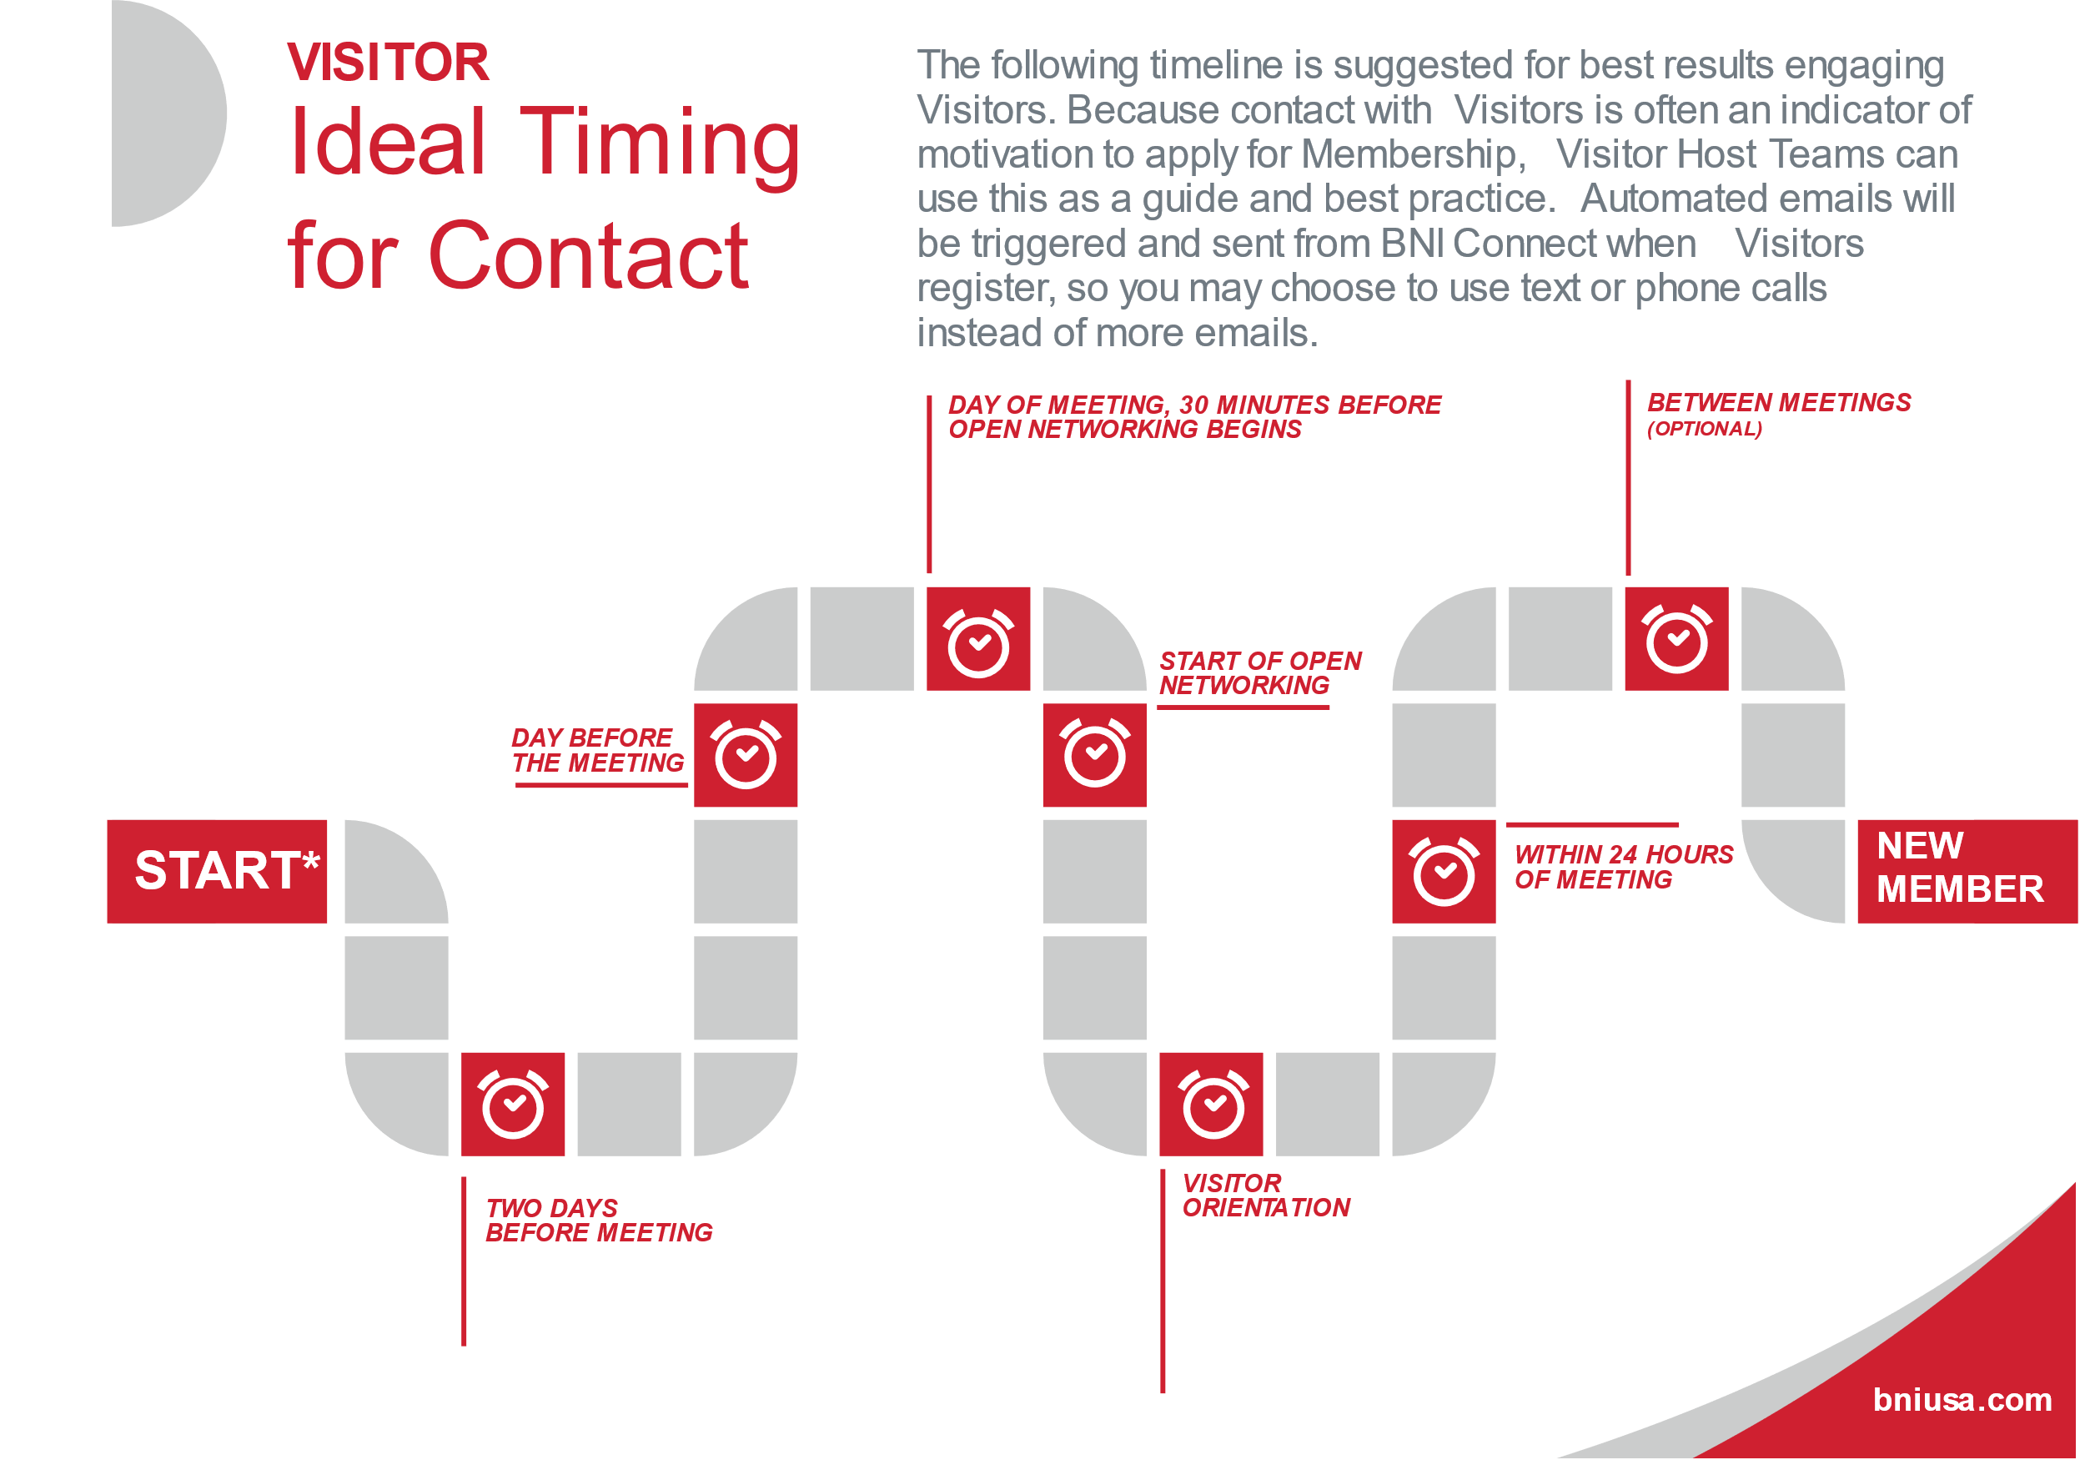
7 TOUCHPOINTS

Slide 6
VISITOR HOST ROLES
Visitor Host Coordinator
Pre-Meeting Host
In Meeting Host
After Meeting Host
2021/2022 Leadership
Team Orientation

Slide 7

The Pre-Meeting Experience
2021/2022 Leadership
Team Orientation

Slide 8
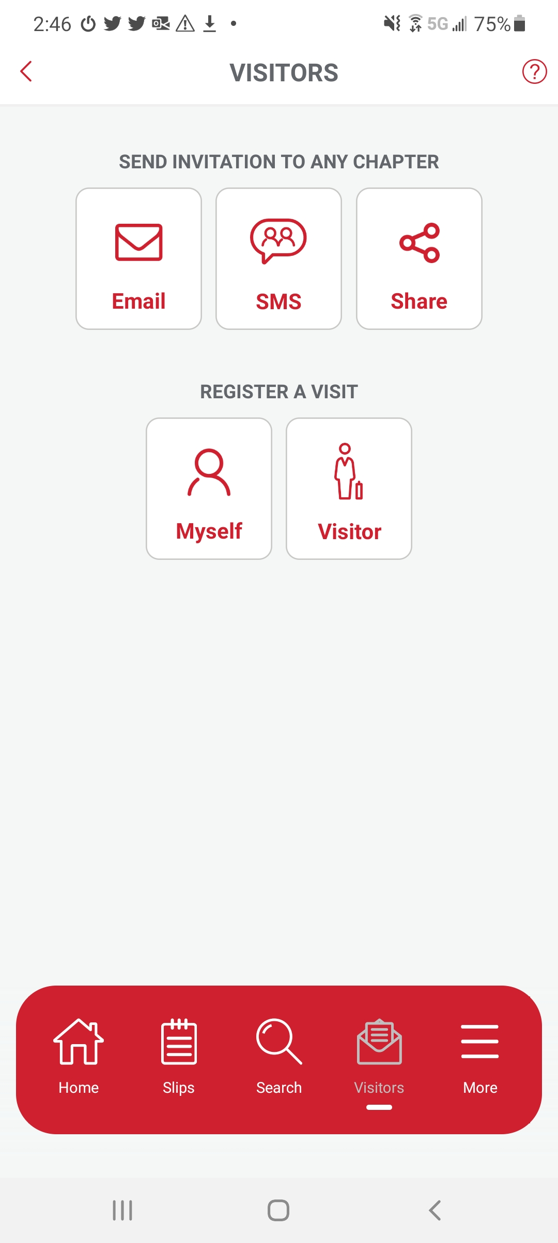

VISITOR INVITATIONS
Members invite by BNI App
Email
Text
Share on Social Media
Members can invite on BNIC
Note: Members DO NOT send a ZOOM link at this time.
2021/2022 Leadership
Team Orientation

Slide 9



Visitor Confirmation by Engage
 | We look forward to meeting you Hi Ken, Welcome, you are confirmed to attend Network Masters Chapter’s Online Meeting on 08/13/2020, at 7:00 AM. Visiting a BNI® meeting is free and gives you the chance to meet several members of your local business community. These introductions can lead to new customers and help you grow your business. This meeting will be held through BNI Online - BNI's virtual meeting space to keep people connected. Meeting Link (if available): The meeting links are unique and some may change weekly. If not available above, the chapter leadership will send you an email a day or so before your scheduled visit with instructions to connect. You can join the meeting with any internet ready device. It would be best if your device had a camera so we can do some "face to face" networking! If your computer doesn't have one, the smartphone app works just as well. Please plan to attend the meeting for the full 90 minutes with some extra time in the beginning to get connected properly and at the end to do additional networking. You will get to connect with lots of other professionals - they will be thrilled to meet you! If it is less than 36 hours to the meeting and you have not yet received your link, please contact the chapter President through email icon on the chapter website or click here and we will get you to the right person.
Immediately upon being registered the Visitor will receive an email confirmation which includes the date and time of the meeting.
They will not receive a Zoom link
at this time.
2021/2022 Leadership
Team Orientation

Slide 10
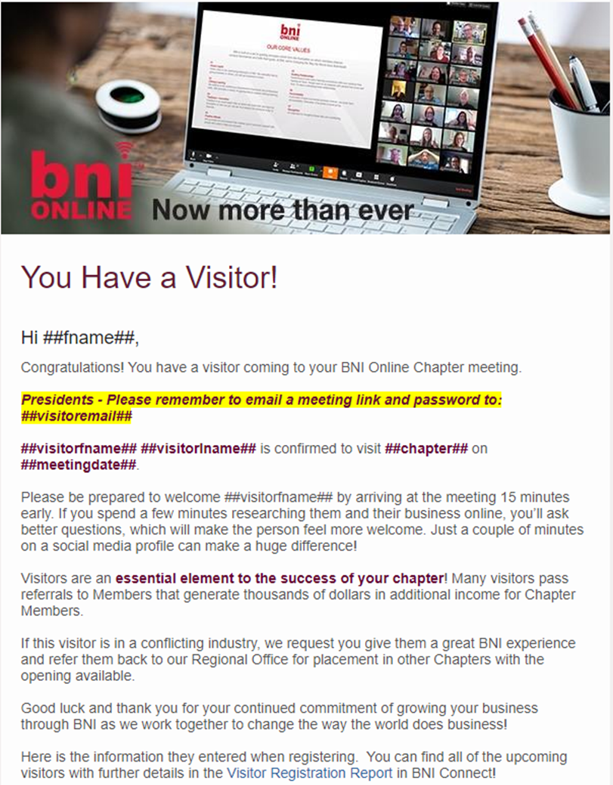
Chapter Notification by Engage
The Chapter Leadership Team, the Visitor Host and the Director Consultant will also receive instant notification of the registered visitor.
2021/2022 Leadership
Team Orientation

Slide 11

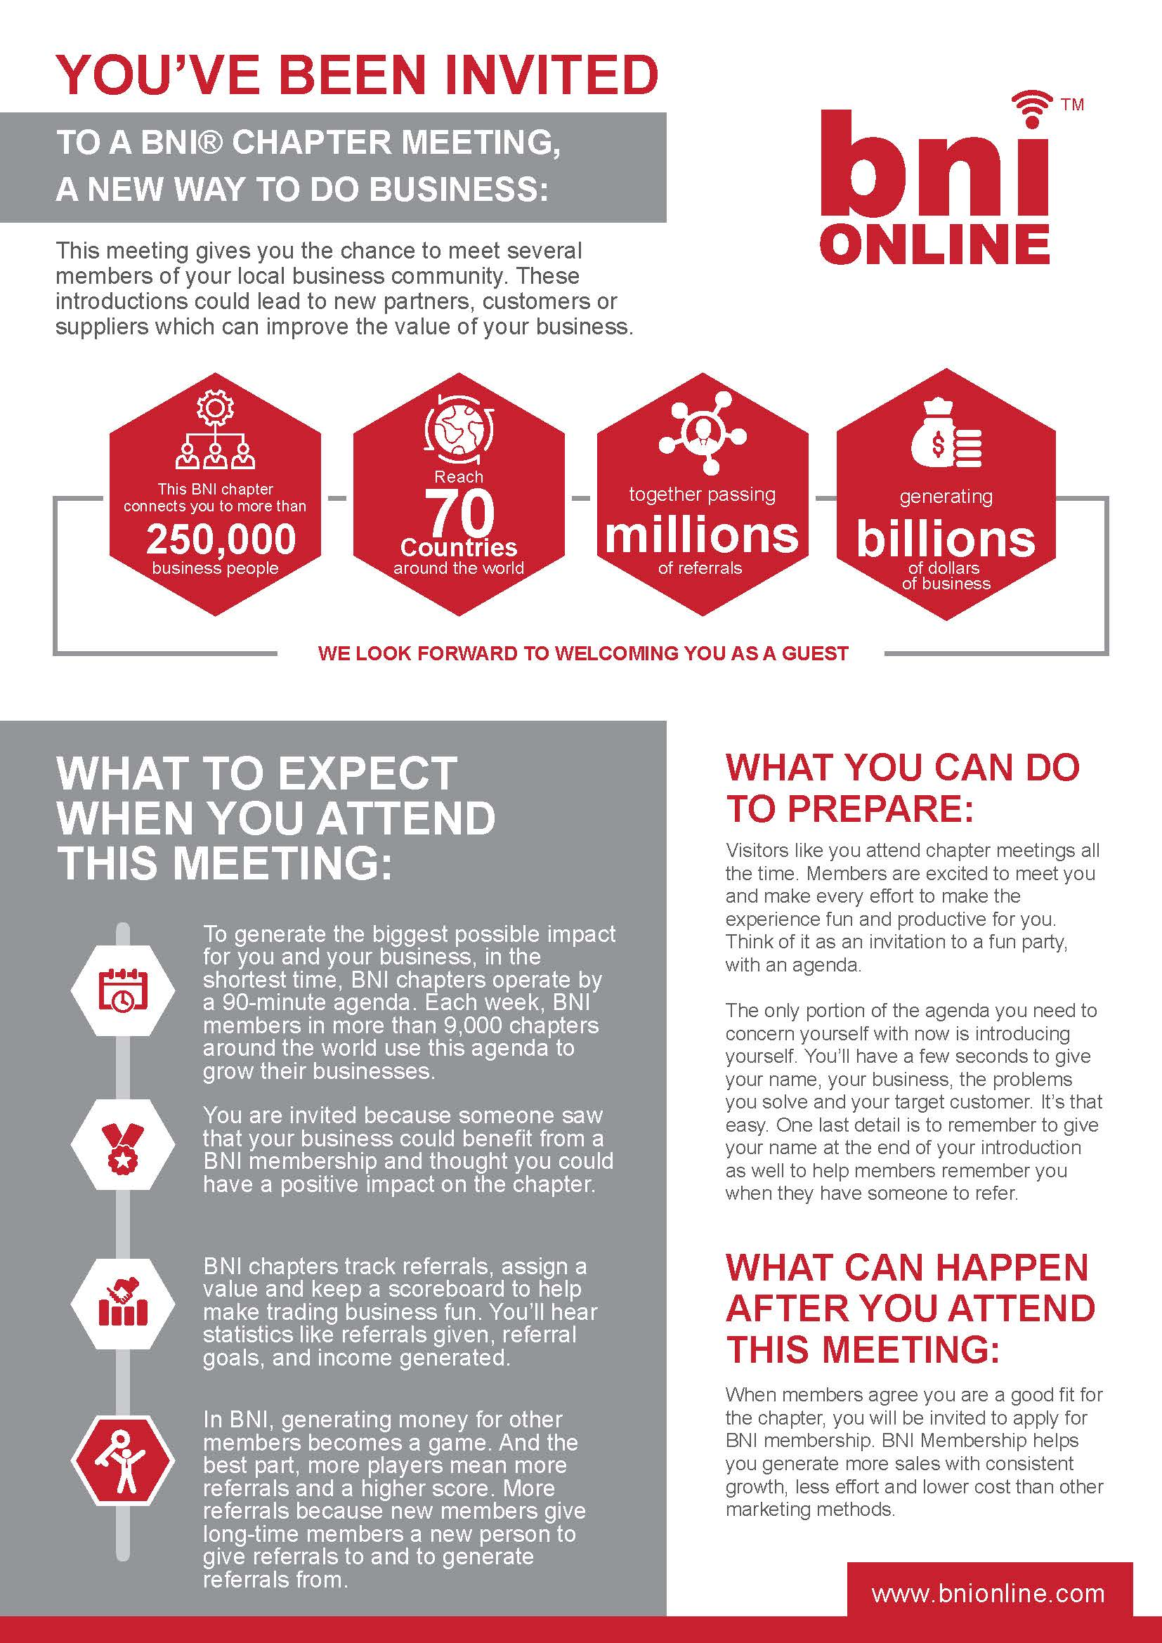
Timely Email to the Visitor by the Visitor Host*
STEP 1: INFORMATIVE EMAILS
Email includes
Meeting Date, Time
Location
OR
Zoom Link
& Password
& Zoom Tips
Slide (optional)
Business cards
Graphic attachment
Dear Visitor:
Thank you for registering to visit the online meeting of BNI Chapter on Date. We’re
looking forward to meeting you and learning about your business! Although we traditionally meet in person in the midst of these unusual times, we will be holding a virtual meeting via Zoom.
We invite you to join us online using this link:
Join Zoom Meeting. INSERT LINK
Meeting ID: insert
Passcode: insert
We recommend using a high-quality headset and webcam to maximize your ability to participate.
Attached are two things:
Your PowerPoint Slide – Please fill this in and email it back to me to be included in our chapter PowerPoints. We want to showcase you in the best possible light.
Our weekly newsletter member roster which is helpful for you to print ahead of the meeting in order to follow along and take notes.
As we do at our in-person meetings, you will have the opportunity to introduce yourself
to the members of the chapter. In an effort to stay timely we will ask you to tell us the
following information when your slide comes up you will have 20 seconds to give us:
1. your name
2. your company name
3. your profession
4. the name of the person who invited you to our meeting
We are looking forward to having you visit our virtual chapter meeting this week. Following are some important details that you need to know and prepare for during our meeting.
All participants should be on camera at all times.
You are representing your business show up professionally both in location and attire
You should be in a quiet location.
You must be in a safe location – no driving during or operating machinery during the meeting.
Please arrive timely (early) so that we can support you getting the most from your visit.
We will introduce you to other members in your power team before the meeting starts.
We will have a breakout for visitors towards the end of the meeting
If you have questions before then, please feel free to contact me at xxx-xxx-xxxx or by
email be at ________________.
Sincerely,
President (Name & Chapter)
2021/2022 Leadership
Team Orientation
*www.BNILTResources.com

Slide 12
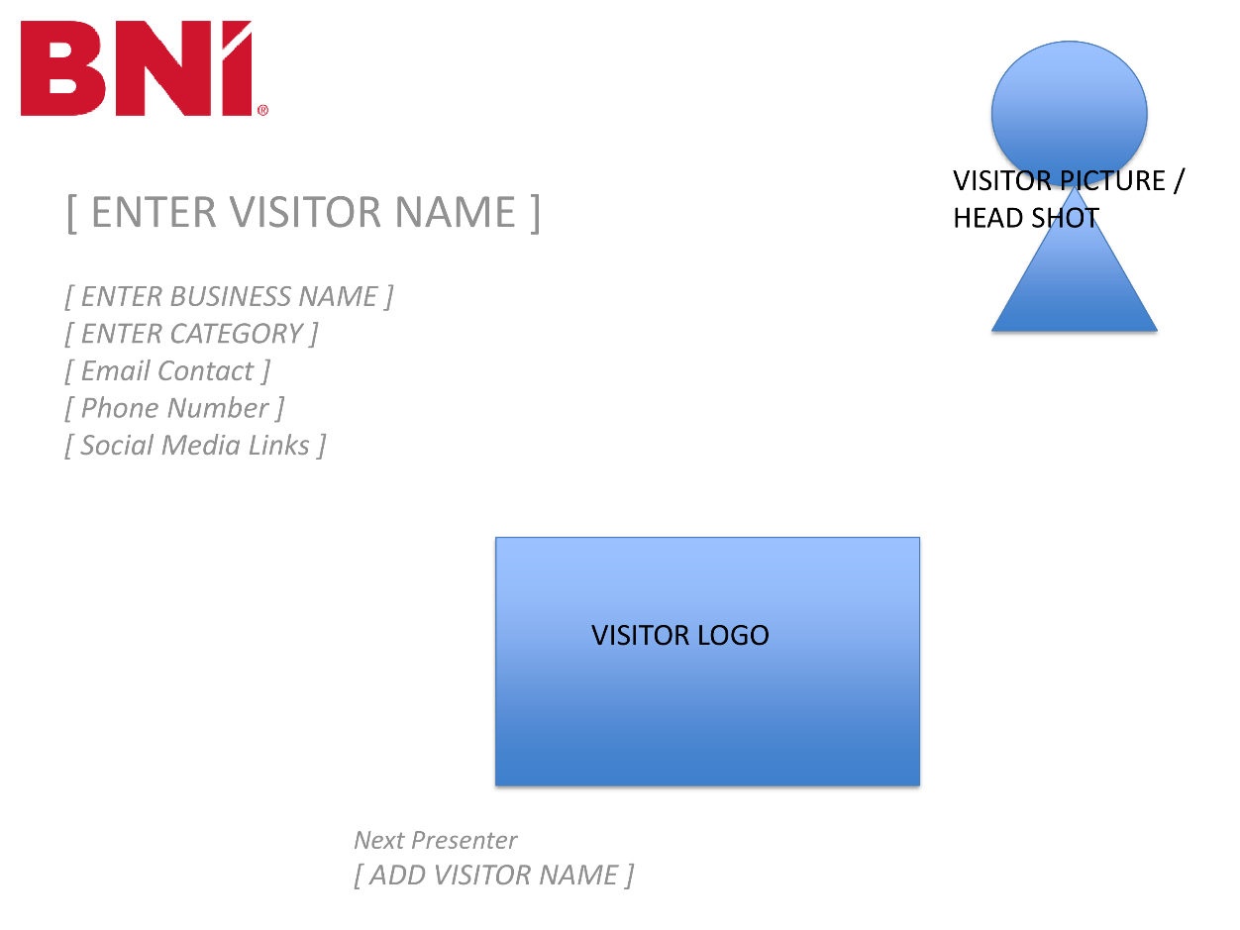
ZOOM VISITOR SLIDES (optional)
What is Genius About This Step?
2021/2022 Leadership
Team Orientation

Slide 13


Visitor Reminder sent by Engage
2 days before the meeting, the Visitor will receive an email reminder like the confirmation they received at registration.
2021/2022 Leadership
Team Orientation

Slide 14

Visitor Reminder sent by Visitor Host
2 days before the meeting, the Visitor Host will send an email reminder to the Visitor. Can include:
Biz card reminder
BYOB
Etc.
2 days before the meeting the Visitor Host can send out to chapter the registration list. Websites? (best practice)
2021/2022 Leadership
Team Orientation

Slide 15
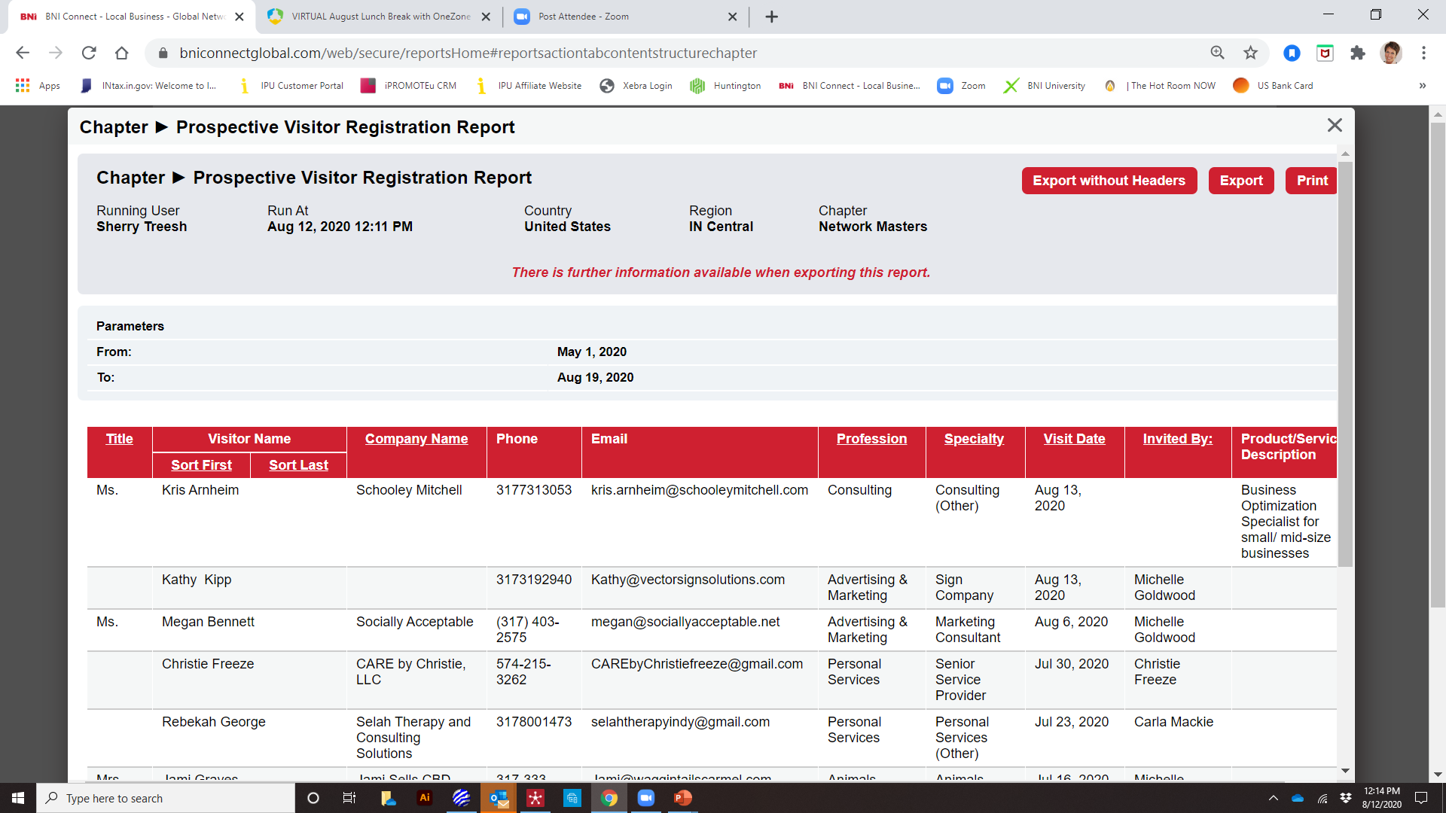
Registration List to LT (chapter – best practice)
NAME
COMPANY
PROFESSION
INVITED BY
2021/2022 Leadership
Team Orientation

Slide 16
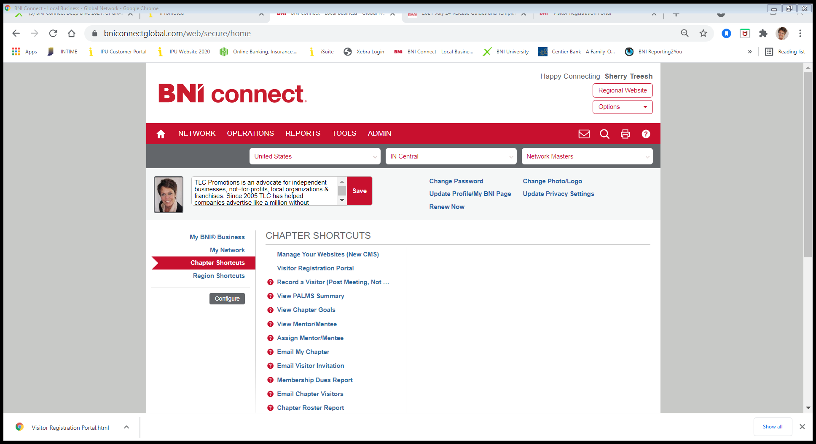
Chapter Shortcuts
Visitor Registration Portal
Key Word: Registration
2021/2022 Leadership
Team Orientation

Slide 17


Confirmation contact by the Member
The Day Before the meeting, the Member reaches out to their Visitor
to confirm.
Specific connections to be made.
Biz, cards, parking, meal.
2021/2022 Leadership
Team Orientation

Slide 18
The Meeting Experience
2021/2022 Leadership
Team Orientation

Slide 19

STEP 2: WARM WELCOME
Set Expectations
Sit with & Coach
Introductions
2021/2022 Leadership
Team Orientation
Notes:
Define guests, visitors & subs. Discuss serial subs. Discuss why Visitors don’t get to ask for referrals & why president introduces them first. Networking facilitator uses the Open Networking 15 minutes to introduce V to power team. This is their time to talk about their business. During meeting we don’t want distractions (business cards at the end not from binder). They should observe the meeting proceedings.

Slide 20

STEP 3: DURING THE MEETING
Power Team Break Out Rooms
Open Networking
Visitors: Listen for & Watch 4 key ideas
Weekly Presentations –Who do they want to meet?
(taking notes keeps visitors engaged)
2. How to introduce self – Reinforce points & timing
3. Vice-President’s Report – This is our scorecard!
4. What impressed you most about the meeting?
(keeps the visitors engage until the end of the meeting.
2021/2022 Leadership
Team Orientation

Slide 21

THANK VISITORS
VISITORS
“What impressed you most about this meeting?”
“Please stay on after the meeting so we can get you introduced to those people you want to meet.”
2021/2022 Leadership
Team Orientation

Slide 22
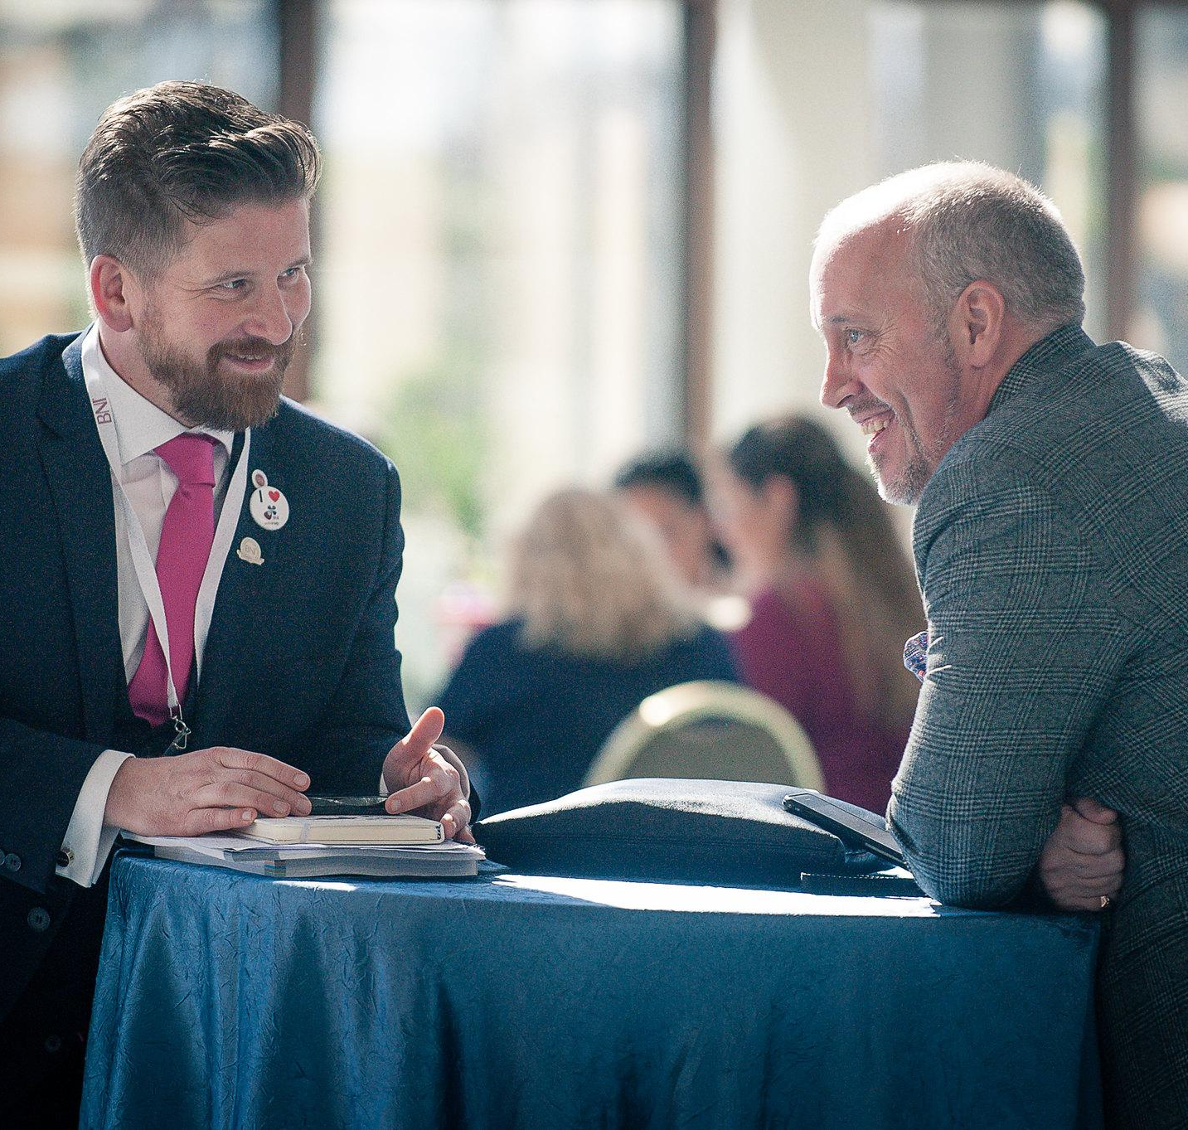
STEP 4: VISITOR ORIENTATION – A Conversation. The Ask.
To the Visitors:
“This a time to get your questions answered, find out who you want to meet & show you how you can become a member of our chapter.”
For Zoom Meetings make this
as conversational as if
you are person. Build trust.
2021/2022 Leadership
Team Orientation

Slide 23
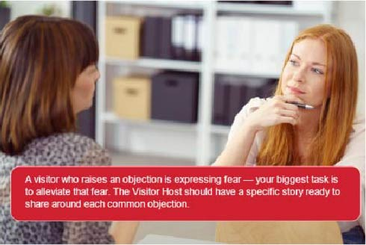
“What impressed you most about the meeting?”
Why?
Wait.
Let the visitors expand
on their response during the meeting.
W.A.I.T. = Why Am I Talking?
What does the Visitor want?
2021/2022 Leadership
Team Orientation

Slide 24
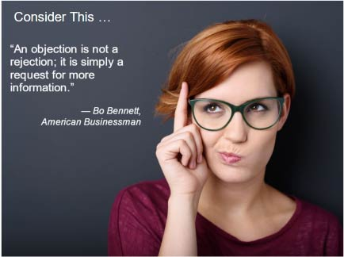

“What are you currently doing to
meet new clients & market your business?”
Be prepared to answer with 1-2 sentence testimonial.
Use a member story if possible.
Summarize & get back to conversation on impressions.
Whose BNI experience can you re-tell?
2021/2022 Leadership
Team Orientation

Slide 25


“Most of our visitors have questions about 2 considerations.
TIME & MONEY
Your 2 finite resources”
90 minute - weekly marketing meeting
3 absences in rolling 6-month period
-allows for substitutes
1-2-1 meeting for referral strategies
Commitment = Return on Investment
Dues are $xxx yearly. Credit card, check or PayPal
One time processing fee of $xxx.
Chapter dues are $xxx.
2021/2022 Leadership
Team Orientation

Slide 26
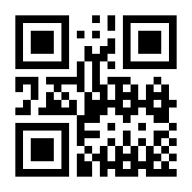
DON’T MISS THIS STEP!
Drop the Link or the QR for the application in the Chat.
or
Have the QR code on your newsletter & business cards.
Ask them to Apply! Be genuine
2021/2022 Leadership
Team Orientation

Slide 27
The Post-Meeting Experience
www.BNILTResources ~ Visitor Host
2021/2022 Leadership
Team Orientation

Slide 28



STEP 5:
Drop the Link or the QR for the application in your follow-up
Follow-up within 24 hours.
2021/2022 Leadership
Team Orientation

Slide 29
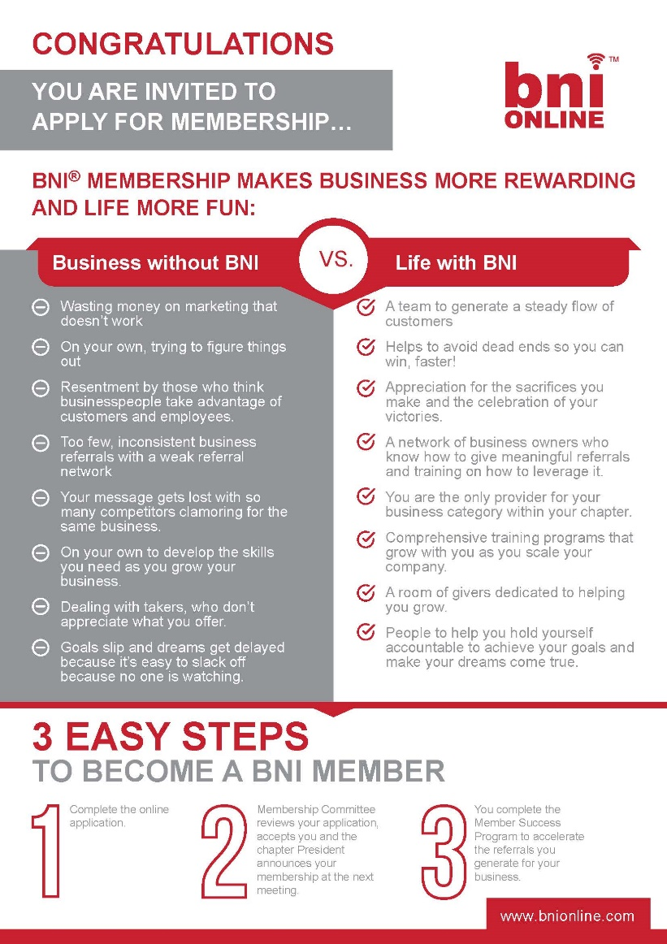
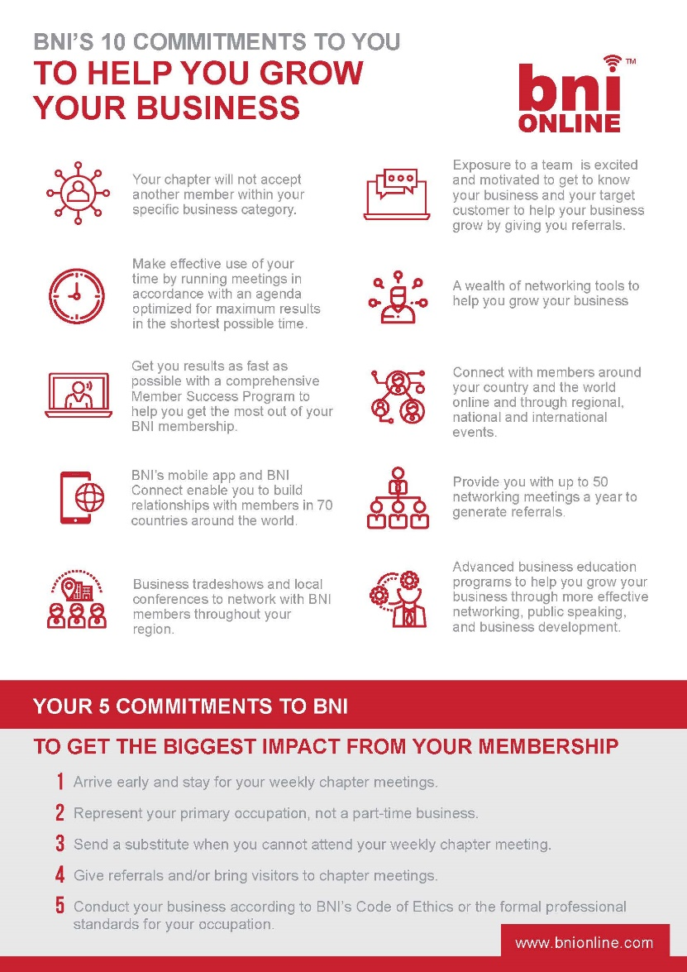
EMAIL ORIENTATION HANDOUTS & LINK / QR CODE
2021/2022 Leadership
Team Orientation

Slide 30
Visitor Host
Follow-up in BNI Connect
(a review of changes)
2021/2022 Leadership
Team Orientation

Slide 31
Chapter Shortcuts
Visitor Registration Portal
Key Word: Registration
2021/2022 Leadership
Team Orientation

Slide 32
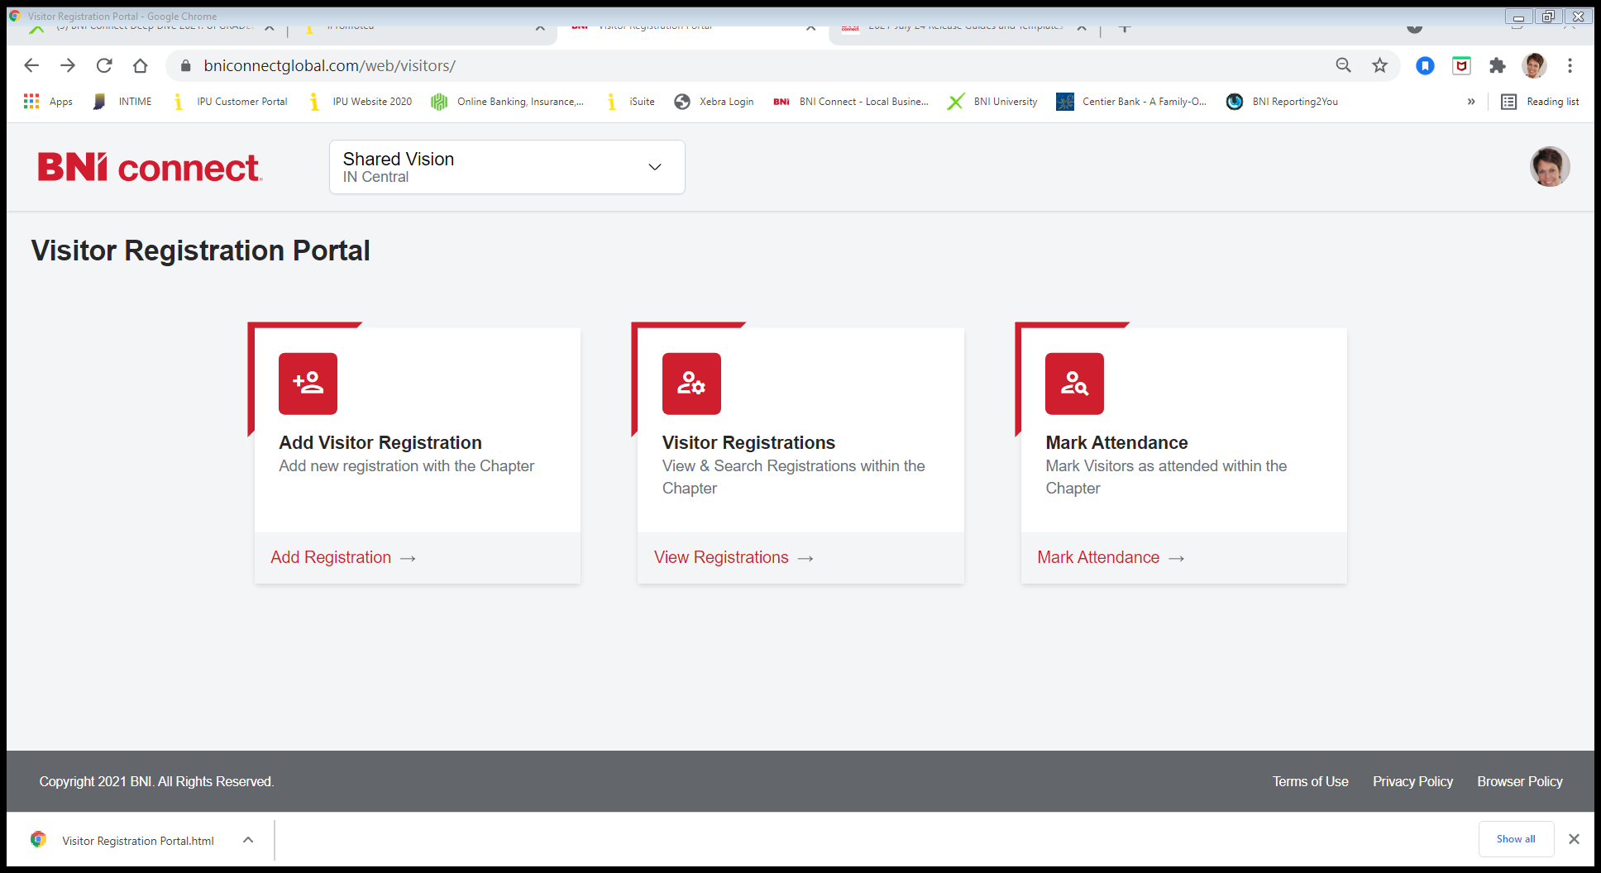
Add Visitor Registration
2021/2022 Leadership
Team Orientation

Slide 33

Visitor Registrations
Mark Attendance
Key Word:
Registration
2021/2022 Leadership
Team Orientation

Slide 34
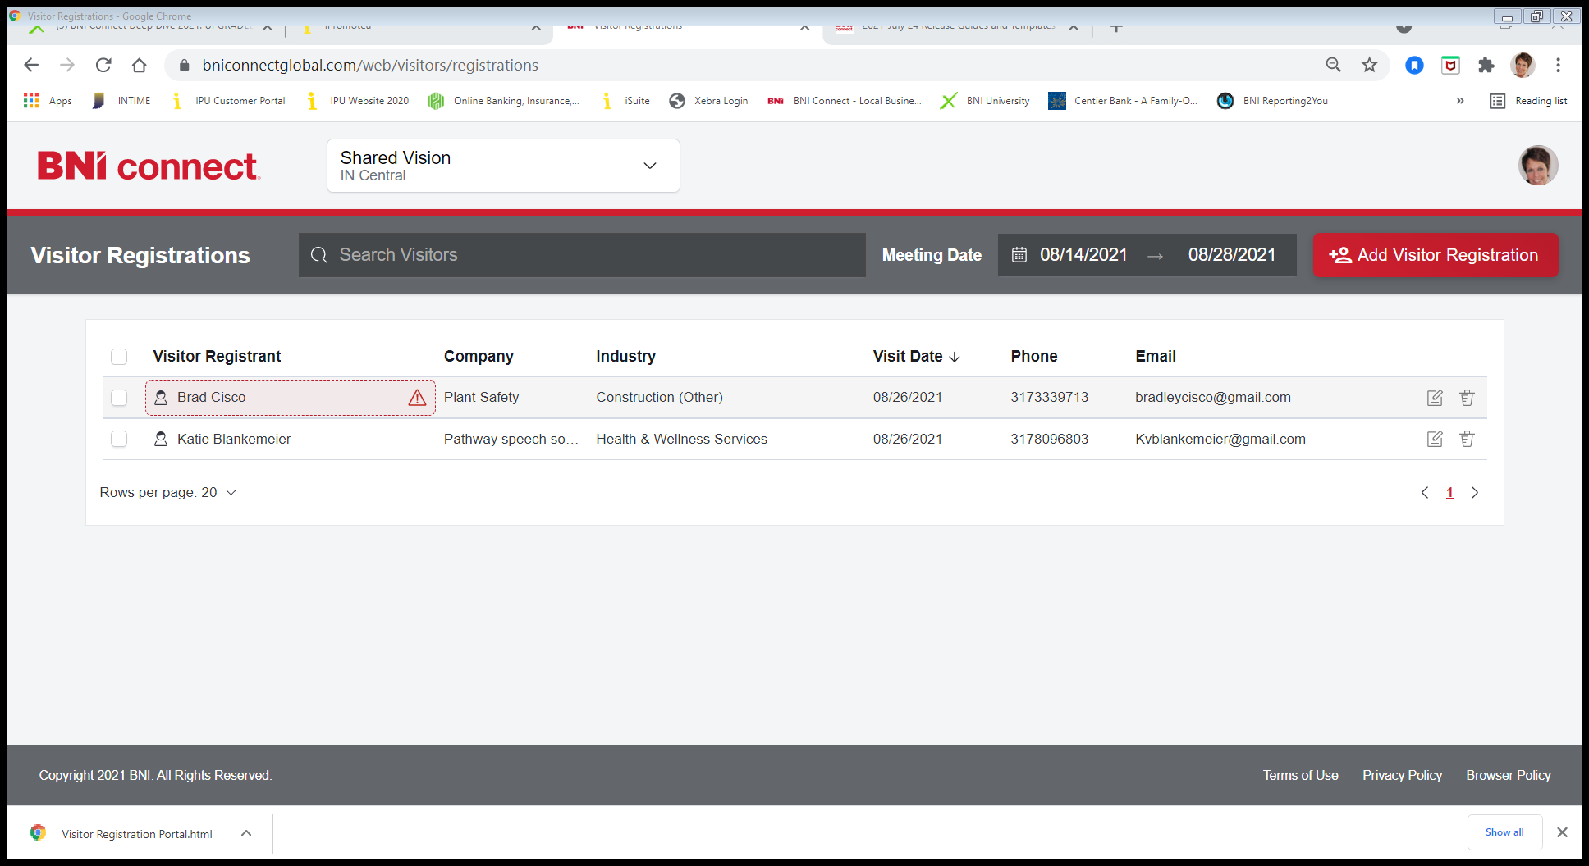
Meeting Date
Visitor Registrant
2021/2022 Leadership
Team Orientation

Slide 35
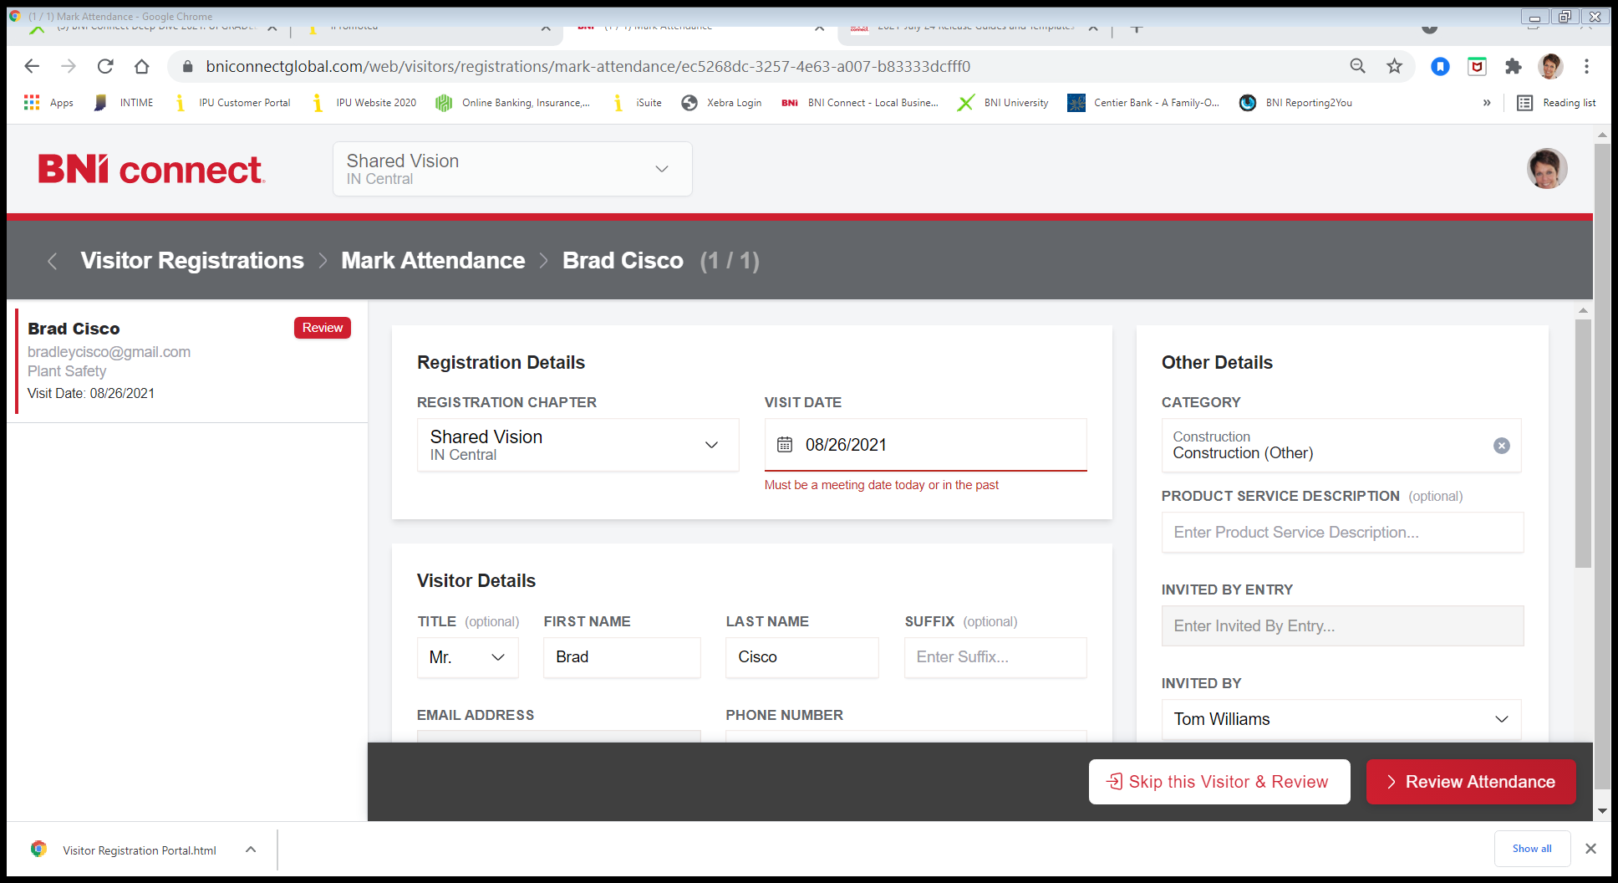
Invited By
2021/2022 Leadership
Team Orientation

Slide 36
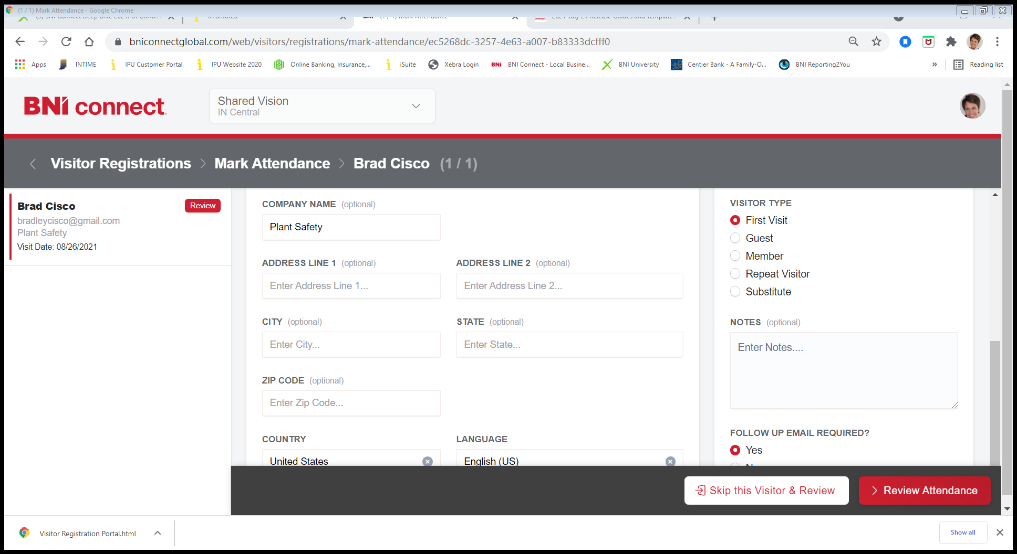
Visitor Type
Follow Up Email Required?
Review Attendance
…then click “Submit”

Slide 37
Chapter Shortcuts
Key Word: Visitors
Email Chapter Visitors
2021/2022 Leadership
Team Orientation

Slide 38

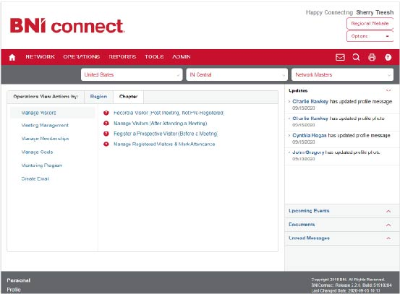
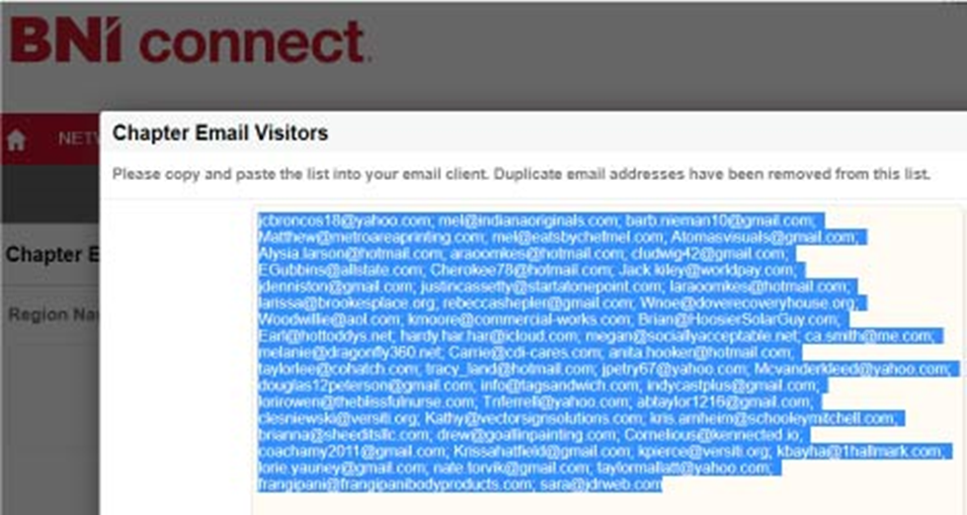
VH Generates Email List
OPERATIONS
Create Email
2021/2022 Leadership
Team Orientation

Slide 39
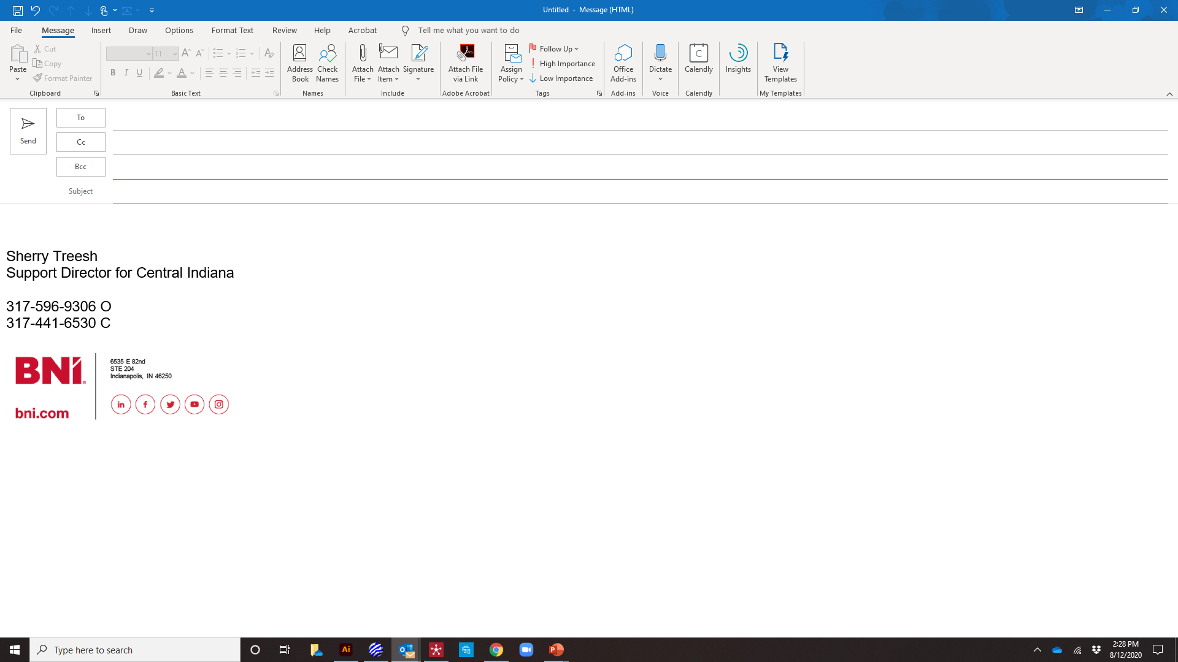
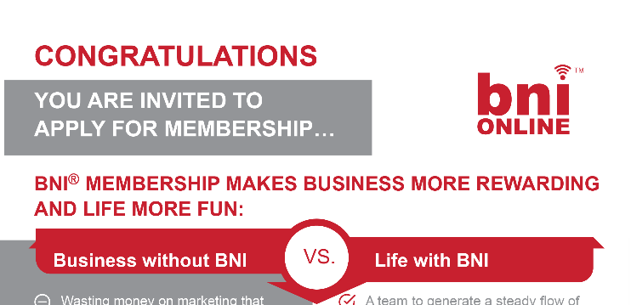
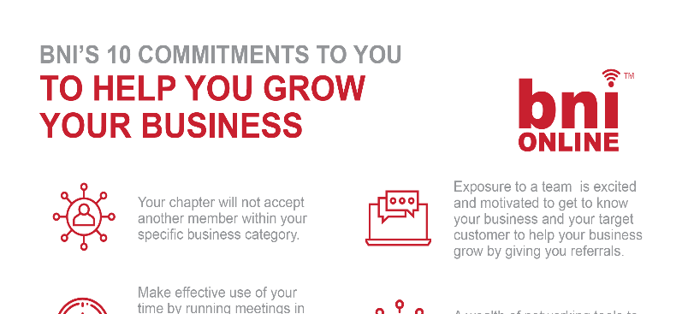
VH Follows-up with all Visitors by email or call
Bcc
Visitor Orientation Attached & Application Link / QR Code
2021/2022 Leadership
Team Orientation

Slide 40


SCHEDULE A VISIT WITH VISITORS
+
Expand Your Network
(best practice)
2021/2022 Leadership
Team Orientation

Slide 41
?
Visitor Hosts Training
Any Questions?
Thank you!
2021/2022 Leadership
Team Orientation

Slide 42
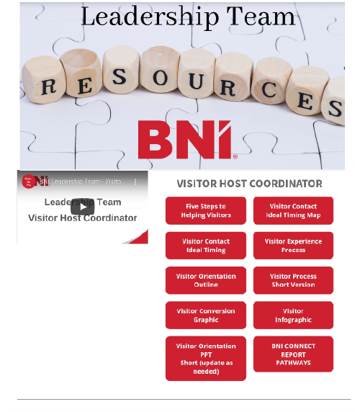

www.bniltresources.com

