Slide 1
WELCOME
Visitor Orientation
Notes:
Thanks for coming today. I hope you met some people and learned some things to help your business going forward. This time on the agenda is dedicated to giving you a bit more information so you can determine whether BNI might be right for your business.
Once they’ve seen a Chapter meeting, most Visitors want to know about TIME and MONEY – The two things we have limited amounts of.

Slide 2
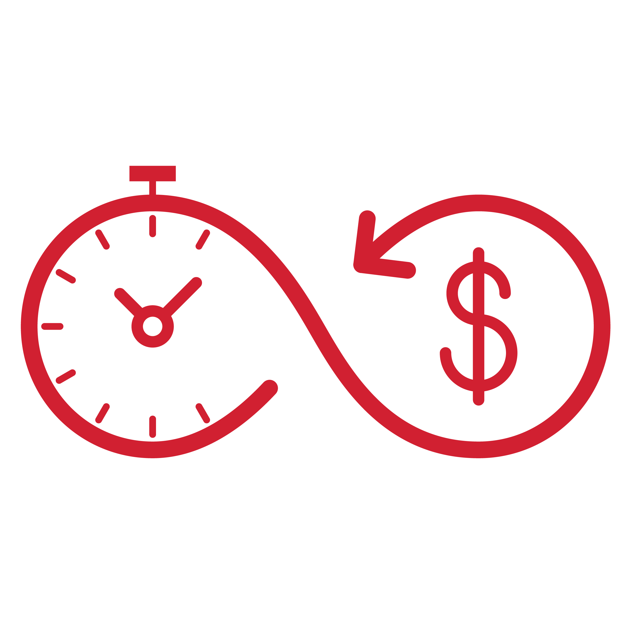
HOW BNI WORKS
TIME
Weekly Meetings
One-to-Ones
Notes:
Let’s start by talking about time. Our weekly 90-minute meetings are crucial in building the trust that generates referrals. We want you here. We mark out meeting time on our calendar just like we would a meeting with a client. When you treat BNI like your best client, BNI will become your best client. We all look forward to the opportunity to hang out with like-minded professionals, but we also know that life happens and we can’t always be here, so we allow for 3 absences in a rolling 6-month period and the ability to send a substitute if something comes up.
Outside our weekly meetings, the real magic happens during what we call One-to-Ones. This is when two members meet to share a meal or coffee. In a One-to-Ones, I am going to learn your bragging points... what sets you apart from others in your industry. I want to know what key situations to look for and how to bring you up in conversation. I want to know what I can do to promote you on social media. These become referral strategy sessions when we actively help on another find our ideal clients. Nowhere else will you get this type of commitment that allows you to see an immediate return on your membership investment.

Slide 3
HOW BNI WORKS
MONEY
$699 Membership Fee
$299 Processing Fee
Notes:
Now money. The cost for the year of membership is $XXX, in addition to a one-time $XXX processing fee. It’s not an application fee because it is not paid until you are accepted. There is not a fee to apply. Our Chapter also has a monthly fee of $XX to help pay for coffee and the venue where we meet. For the time commitment and investment of a BNI Membership, nothing compares to the results our Members get from personal referrals.

Slide 4
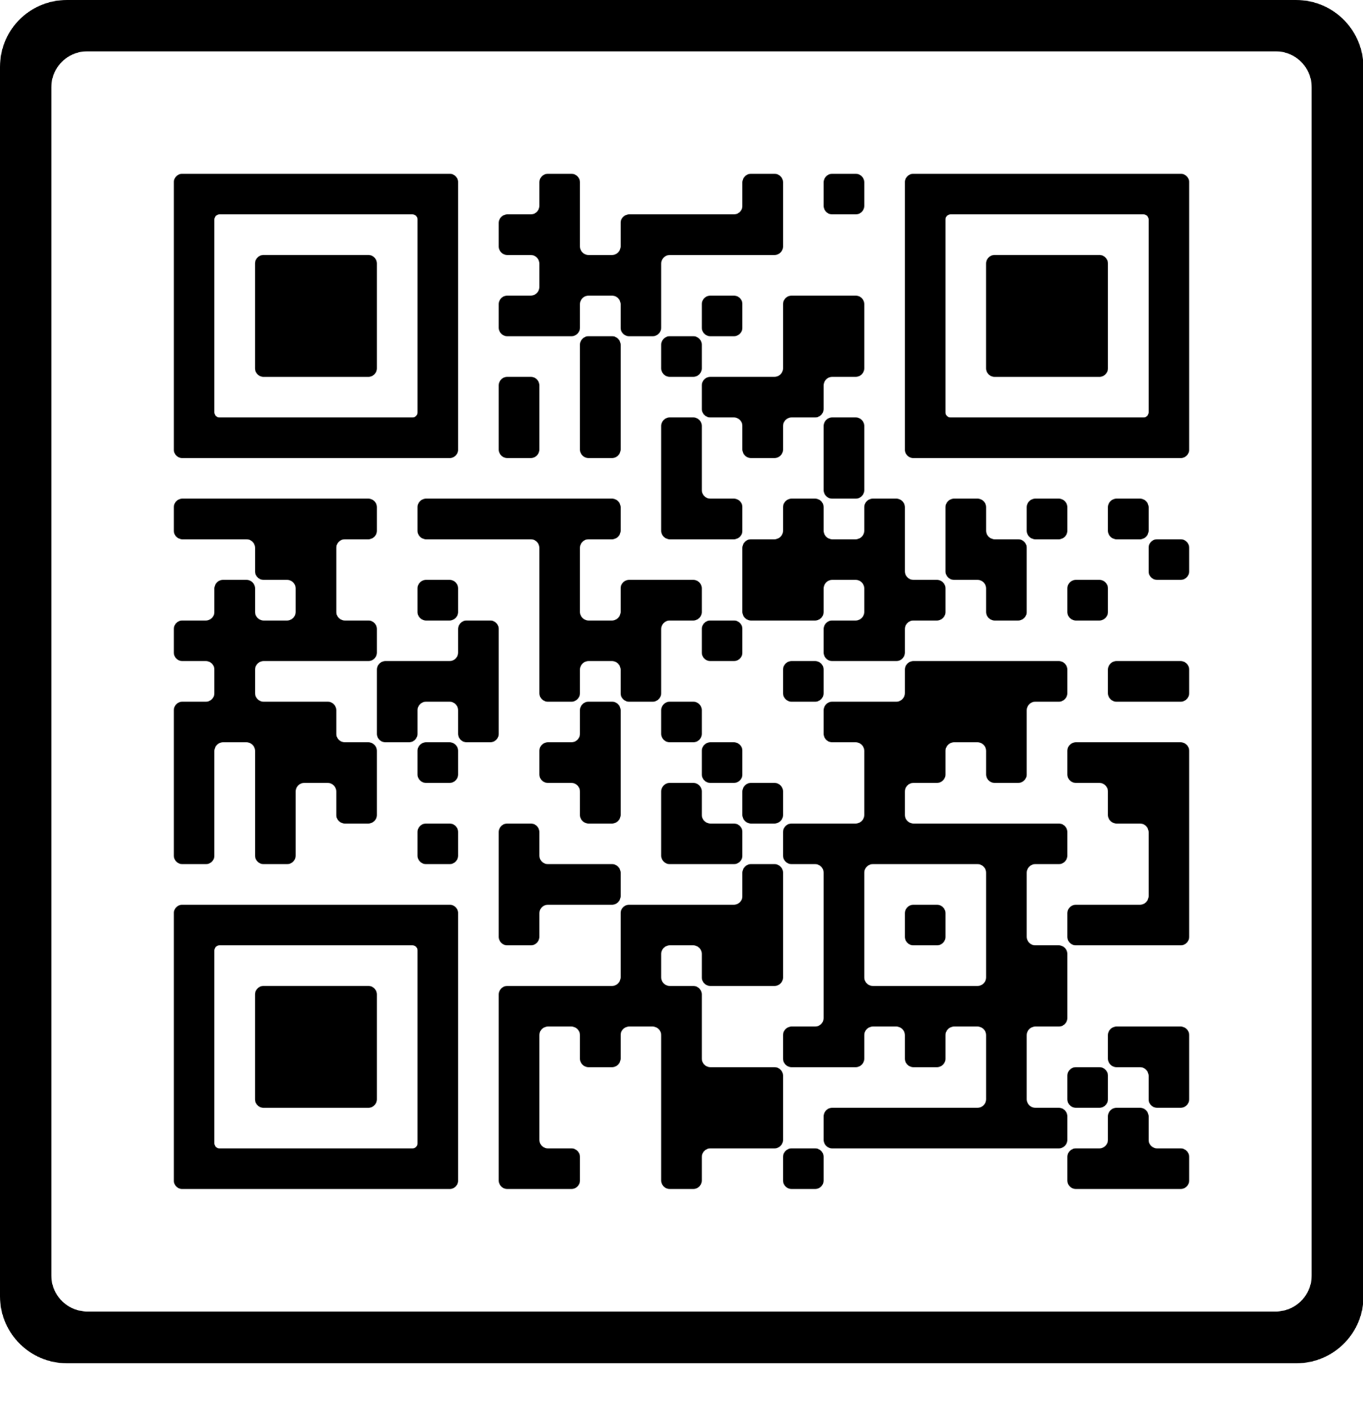
WHAT’S NEXT?
APPLICATION
FOLLOW-UP CALL
https://bit.ly/BNIapplynow
Notes:
If this resonates with you and you’d like to apply to the Chapter, simply hold your phone’s camera to this QR code for a link to get you started on the process. You could also go to the link below.
If you’re thinking about how this could work for your business, but you need to crunch numbers or talk to someone at home or in your office, that’s ok. Someone from our Chapter will call you in the next 24 hours to see if you have questions.
And if there’s someone you’d like to bring to the meeting next week so they can experience what you’ve experienced today, we’ll help you get registered.

